Slide 1

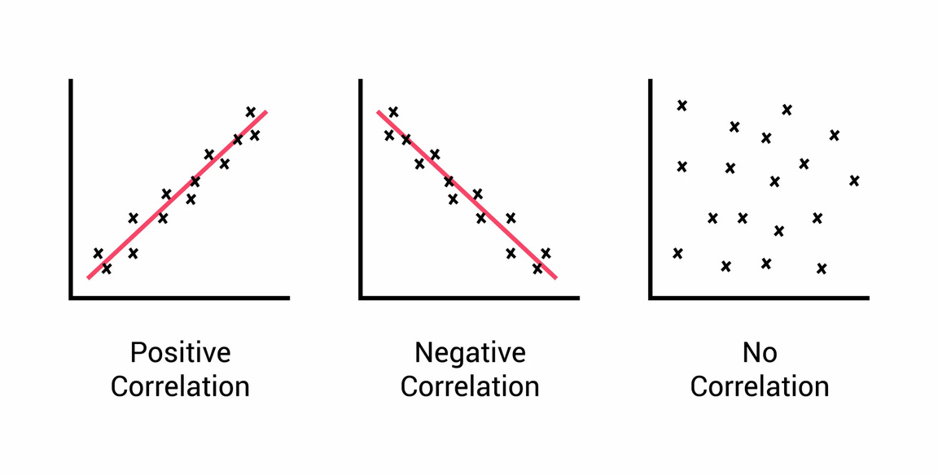
Analysis of results

Slide 2
HEAT MAP

Slide 3
CORRELATION BETWEEN VARIABLE PAIRS
STRONG CORRELATION >(0.70)
WEAK OR NEGATIVE CORRELATION
1. Sqft_above ↔ sqft_living → 0.88
2. Grade ↔ sqft_living → 0.76
3. Sqft_living ↔ sqft_living15 → 0.76
4. Sqft_above ↔ grade → 0.76
5.Sqft_living ↔ bathrooms → 0.75
Condition ↔ Floors → -0.26
Sqft_basement ↔ Floors → -0.24
Sqft_above ↔ condition → -0.15
Grade ↔ condition → -0.14

Slide 4
FACTORS AFFECTING PRICE
KEY INSIGHTS WITH REGARD TO PRICE
Larger living area strongly drives up prices.
Higher grade (construction/finish quality) means higher price.
Bedrooms and bathroom alone aren’t strong predictors.

